Slide 1

Hospitality analysis
Mentor Name :
Alka Dinesh Aswar

Slide 2
Group Details
Team Members :
Rohit Patil
Pratiksha Nagane
Rina Gajghate
Shantasri Hangargi

Slide 3
INTRODUCTION
The Hospitality Analytics Project focuses on analyzing hotel booking data to uncover key business insights.
The goal is to optimize occupancy rates, increase revenue, and improve customer satisfaction.
Key Metrics in Focus :Occupancy rate, ADR(Average Daily Rate), RevPAR(Revenue Per Available Room), Cancellation% Total Revenue.
Tools used :Excel, Power BI, Tableau, SQL.

Slide 4
BUSINESS PROBLEM
Problem : Hotel face challenges in understanding booking patterns, cancellations, and customer preferences.
What to Do : Collect and analyze booking data,Cleaely define the problem,Analyze the each cause,Explore possible solutions,Implement action plan.
How to Do : Use SQL for cleaning, Excel for processing, Power BI and Tableau for visualization.
Insights : Seasonal trends, top hotels, customer demographics, revenue growth,Occupancy trends, Customer booking patterns, Revenue insights, cancellations & No shows, Length of stay analysis.

Slide 5
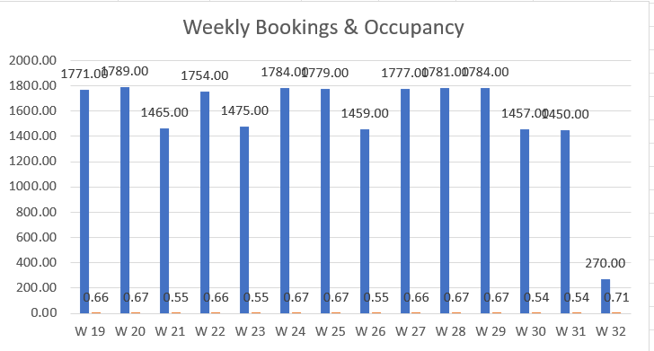
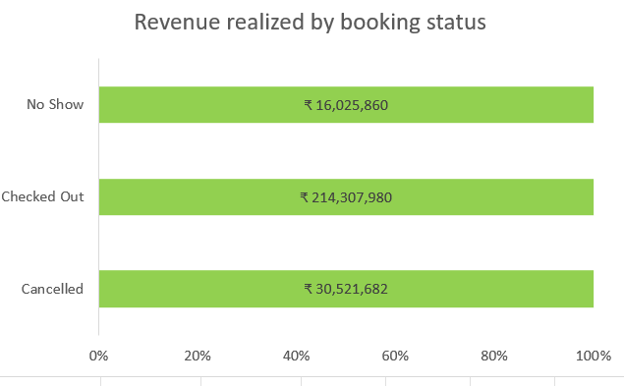
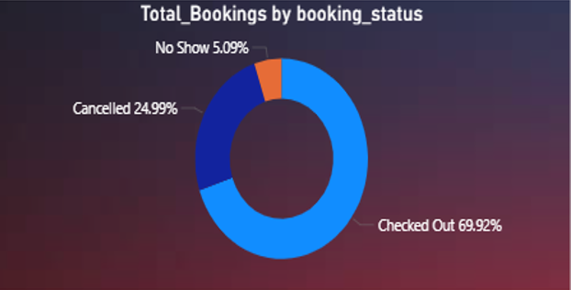
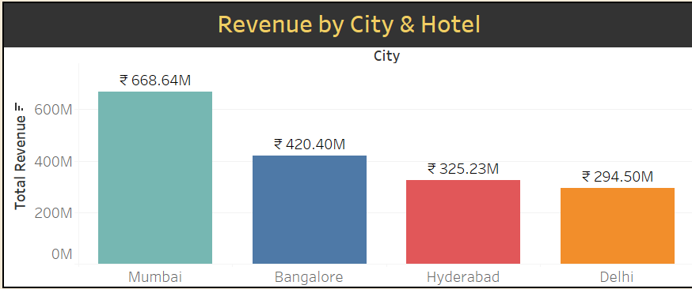
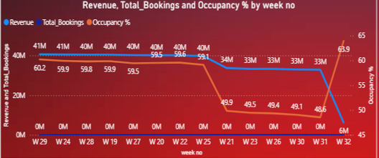
VISUAL ANALYTICS

Slide 6
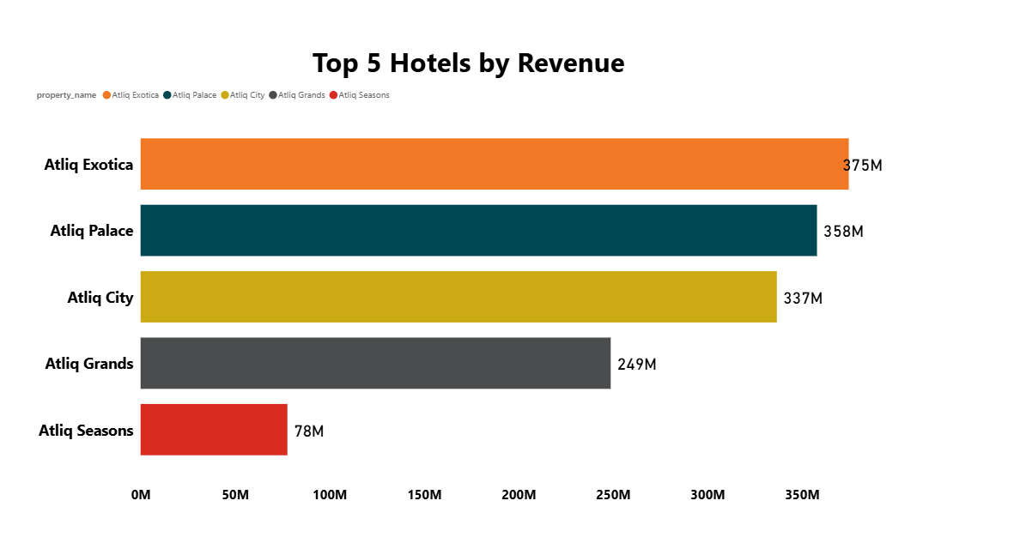
TOP 5 HOTELS ANALYSIS
The bar chart shows the Top 5 Hotels by Revenue. Atliq Exotica leads with the highest revenue of 3.75M, followed by Atliq Palace (3.58M) and Atliq City (3.37M). Atliq Grands earned 2.49M, while Atliq Seasons recorded the lowest at 78M.Overall, the chart highlights that Atliq Exotica dominates revenue among the top hotels.

Slide 7
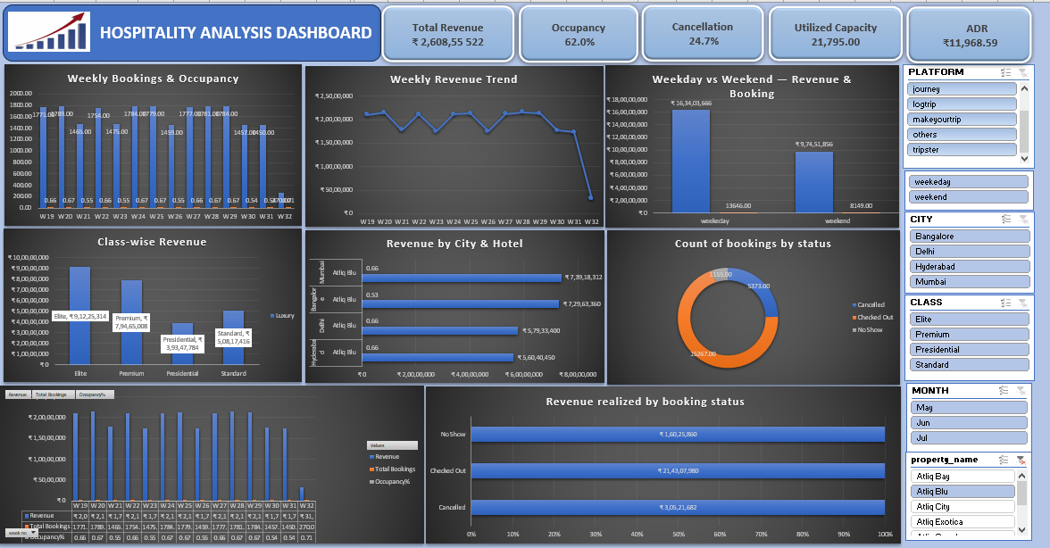
EXCEL DASHBOARD

Slide 8
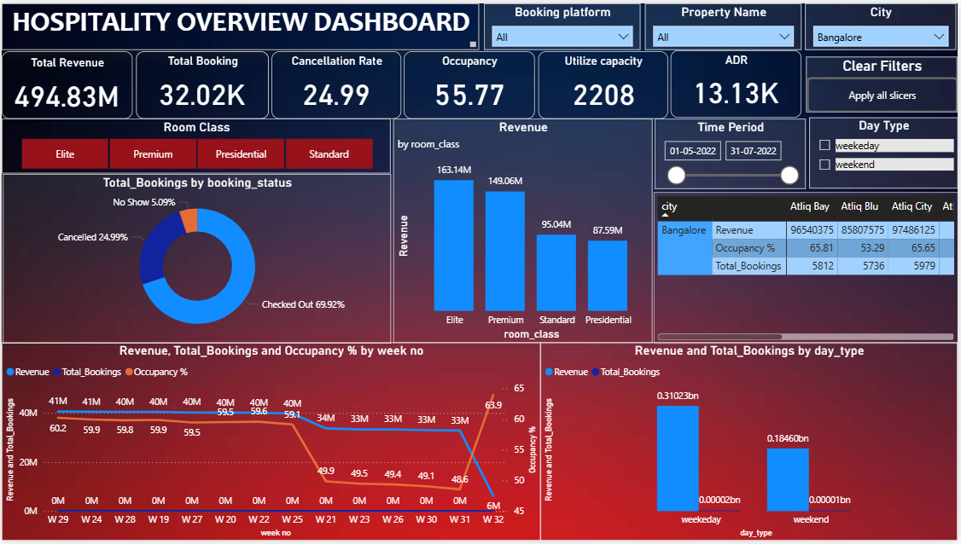
Power BI Dashboard

Slide 9
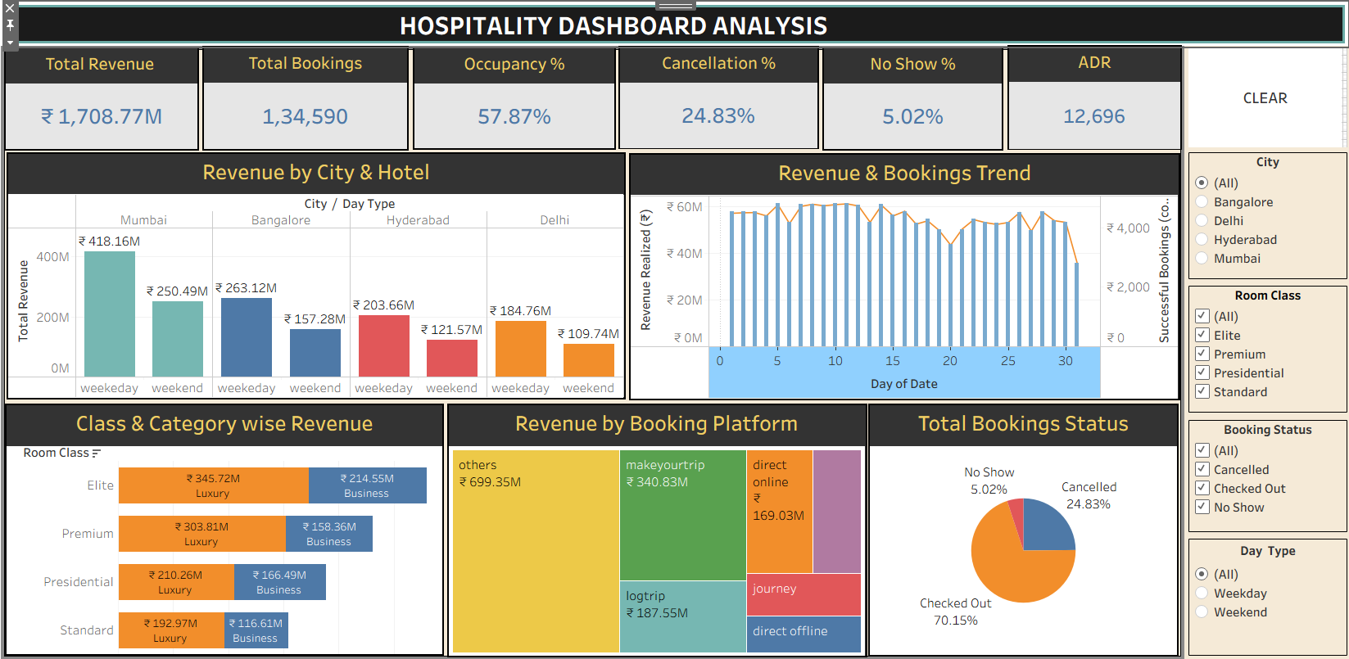
Tableau Dashboard

Slide 10
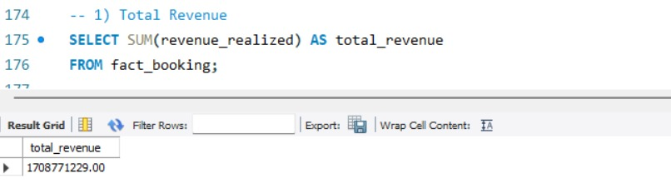
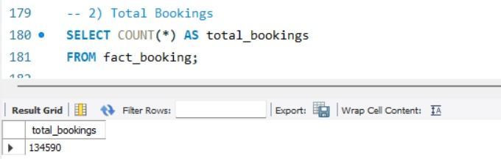
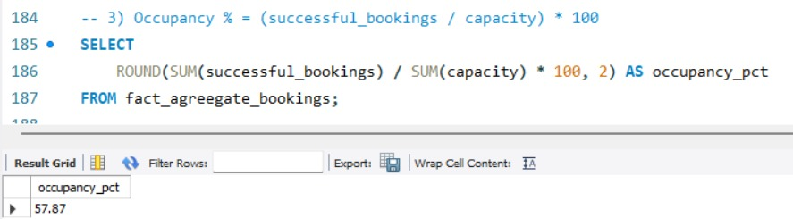
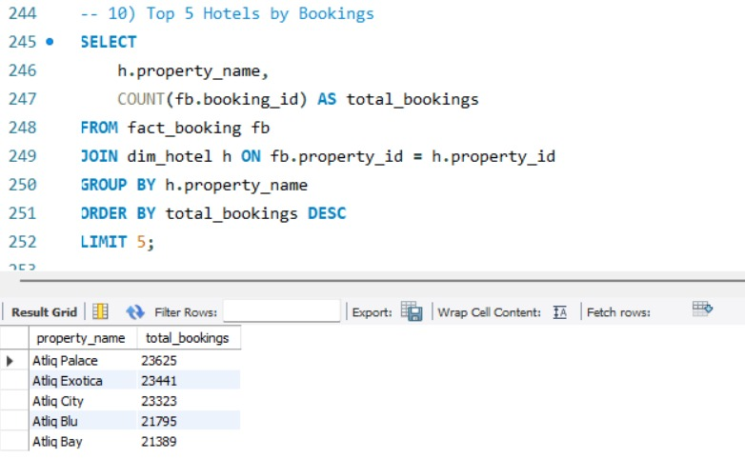
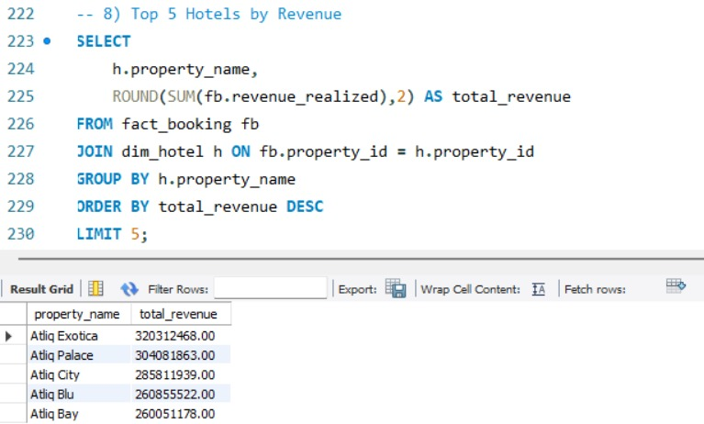
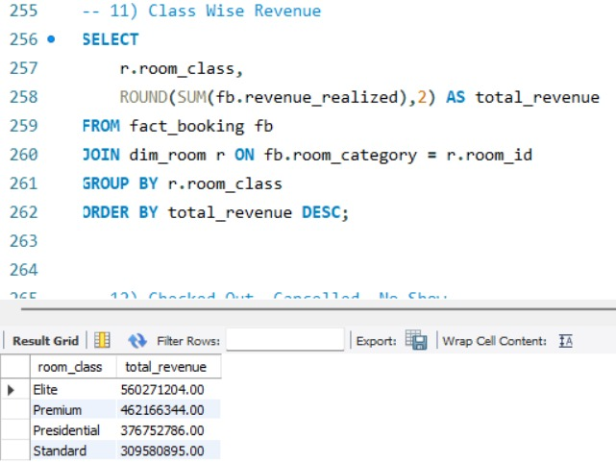
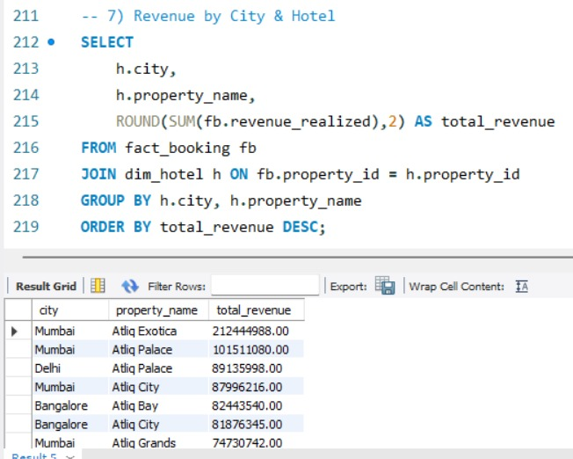
SQL QUERIES

Slide 11
RECOMMENDATIONS
Improve customer loyalty programs.
Optimize pricing strategies based on seasonality.
Focus on reducing cancellations with better policies.
Use predictive analytics to forecast occupancy.
Enhance digital marketing based on customer insights.

Slide 12
THANK YOU

